Slide 1



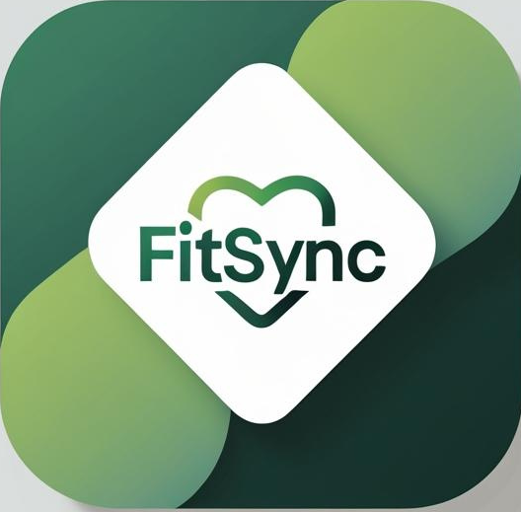
Fitsync: Mindful Fitness
Unite fitness and mindfulness for a healthier, more focused lifestyle.

Slide 2


Embrace a Healthier Mindset

Slide 3


Uniting Fitness and Mindfulness
A holistic approach to enhancing well-being ,focus and productivity.

Slide 4


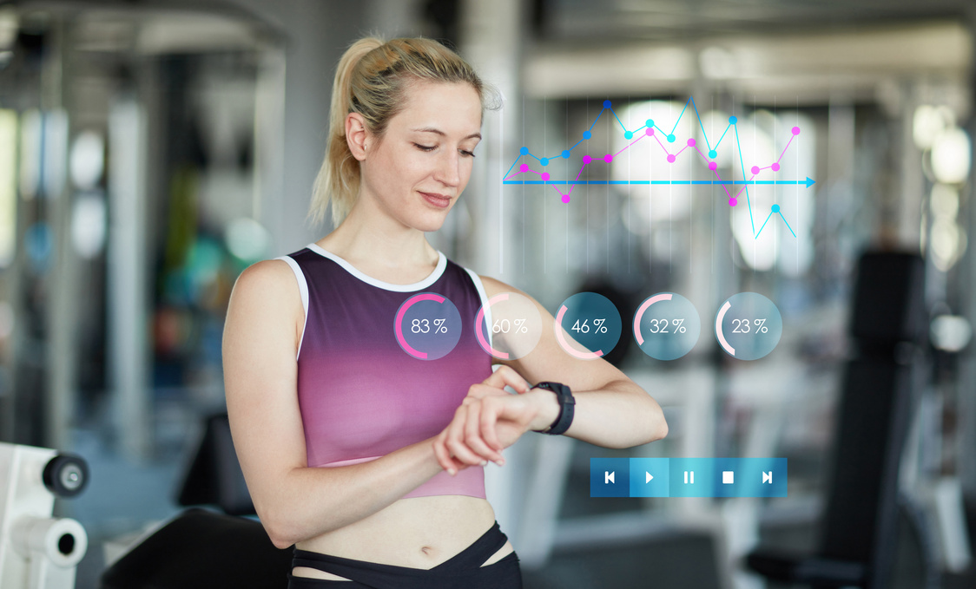

Our Solution: Key Features
Fitness Tracking: powered by Google fit
Soothing Music
Enjoy calming melodies that enhance your focus and relaxation during workouts.
Monitor your progress and stay motivated with real-time tracking features.

Slide 5

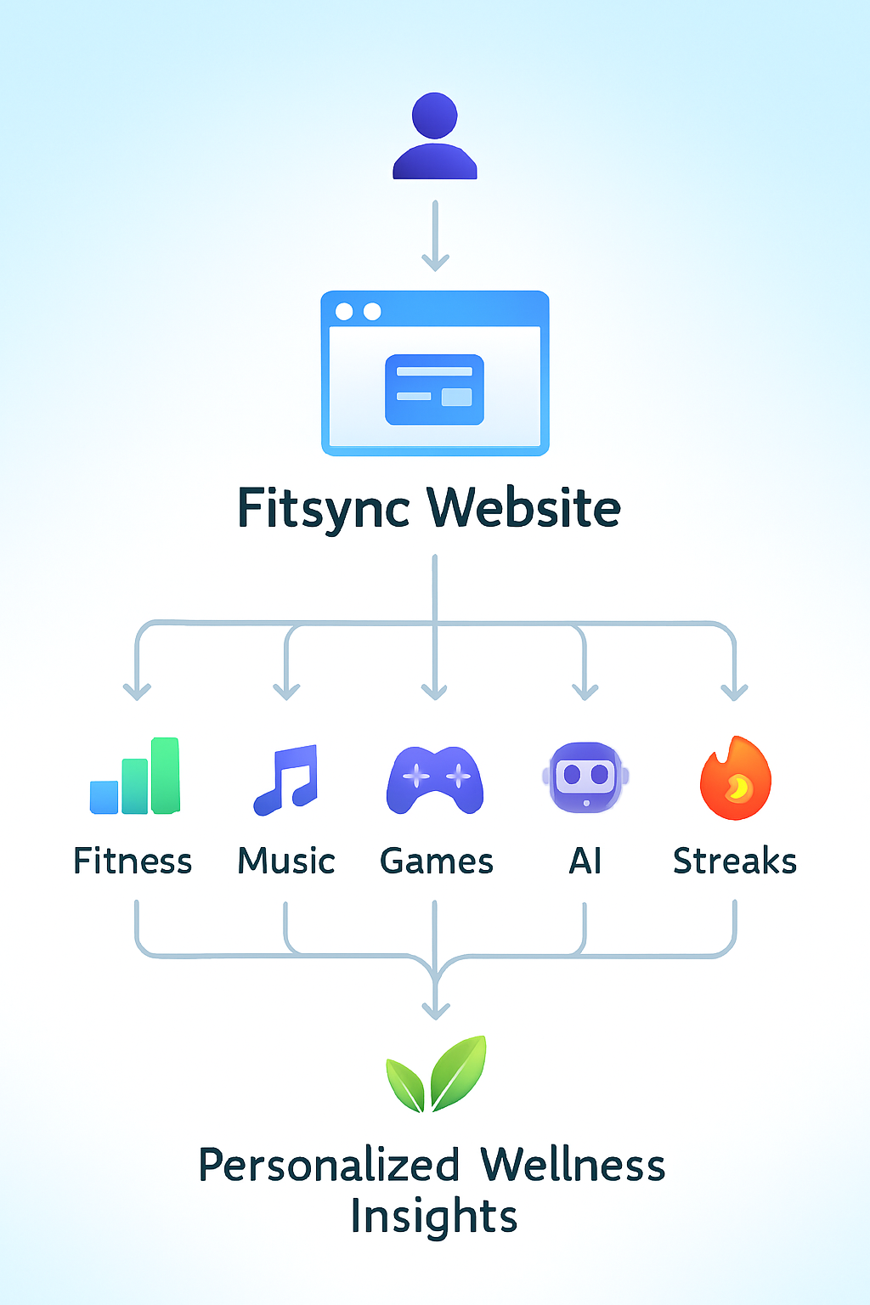
Understanding the Fitsync Flow Diagram
This diagram illustrates how Fitsync seamlessly integrates fitness and mindfulness.

Slide 6



Fostering a Healthier Lifestyle
Fitsync promotes mindfulness and fitness through integrated wellness practices.

Slide 7

Fitsync Milestones in Action
Launch
First Update
User Feedback
Expansion
Initial app release date
Added mindfulness features
Enhanced user experience
New features and regions

Slide 8


Future Enhancements for Fitsync
Phase One
Phase Two
Phase Three
Phase Four
Phase Five
Launch mindfulness feature
Introduce AI chatbot
Expand music library
Enhance user dashboard
Roll out fitness streaks

Slide 9


“Your path to mindfulness and fitness begins here.”
– Fitsync Team

Slide 10


Reach out to us for more information
Email
Garvik.jain2024@vitstudent.ac.in
Durgesh.kumar2024@vitstudent.ac.in
Shaikh.mahboob2024@vitstudent.ac.in
Ishani.ghosh2024@vitstudent.ac.in
Phone
8603950173

